Slide 1

SMART ELECTRICITY MONITORING SYSTEM (SEMS)
TEAM MEMBERS-
SHIVARANJANI.T -- 412513205069
SUBATHRA.P -- 412513205079
VAISHALI.V -- 412513205090
GUIDED BY –
MS. M.ANANTHI, B.E, M.E,
- ASSOCIATE PROFESSOR
Smart Electricity Monitoring System (SEMS)
Department of Information Technology
Sri Sairam Engineering College

Slide 2
OBJECTIVE
Electricity is taking lion’s share of the income.
Greater control over the electricity consumed.
Power consumption of devices computed by an integrated embedded kit.
Senses the natural light and temperature
Alerts sent to user through SMS.
Smart Electricity Monitoring System (SEMS)
Department of Information Technology
Sri Sairam Engineering College

Slide 3
PRESENT SCENARIO
TNEB readings - Bimonthly
Manual and e-bill payment
DISADVANTAGES:
Per device consumption unknown.
SMS received bimonthly stating amount.
Smart Electricity Monitoring System (SEMS)
Department of Information Technology
Sri Sairam Engineering College

Slide 4
LITERATURE SURVEY
LITERATURE SURVEY
PAPER NAME | EXISTING SYSTEM | ENHANCEMENT REQUIRED
[1] Household Electricity consumption analysis with Data Mining Techniques 2016 | Data mining techniques on two different public data set . Electricity consumption patterns analyzed. | Only analysis. No control measures.
[2] Electricity consumption analysis and power quality monitoring in commercial buildings 2015 | Meta-heuristic algorithms are used on power consumption data sets Efficiency and quality are analyzed. | Efficiency and quality of power alone is measured
[3] Electricity-Metering in a Connected World: Virtual Sensors for Estimating the Electricity Consumption of IoT Appliances 2015 | Software based virtual energy sensors calculates energy consumed by IoT devices. | Enhancement-Mobile alerts.
Smart Electricity Monitoring System (SEMS)
Department of Information Technology
Sri Sairam Engineering College

Slide 5
LITERATURE SURVEY (Contd…)
PAPER NAME | EXISTING SYSTEM | ENHANCEMENT REQUIRED
[4] Analysis of the residential, commercial and industrial electricity consumption 2015 | Electricity consumption along with light and temp parameters are gathered on daily basis. | No alerts provided.
[5] An Intelligent Energy Management Scheme with Monitoring and Scheduling Approach for IoT Applications in Smart Home 2015 | Electrical usage and appliance history is collected through statistical analysis and context-aware technologies. | Enhancement: Light and temperature sensors are additionally used to save energy.
Smart Electricity Monitoring System (SEMS)
Department of Information Technology
Sri Sairam Engineering College

Slide 6
PROPOSED SYSTEM
Power consumption of each device is monitored.
Cumulative consumption computed
SMS Alert if it overruns threshold.
Natural light & Temperature sensed periodically.
SMS Alert if sufficient light intensity/ temperature available.
ADVANTAGES:
Monitors the power consumption periodically.
Periodic alerts on reaching threshold.
Helps save electricity.
Cumulative report of usage.
Smart Electricity Monitoring System (SEMS)
Department of Information Technology
Sri Sairam Engineering College

Slide 7
HARDWARE REQUIREMENTS
Plug Sockets
ADC 0809
Microcontroller 89S52
Temperature sensor LM35
Light sensor LDR
Max 232 chip
Transistor Amplifier 2003
Rectifier 1N4007
Capacitor
Regulator 7805
Global System for Mobile communications (GSM)
2 bulbs
Laptop –
CPU i5 CORE processer
RAM 1 GB
Hard Disk 80 GB
Mobile Phone
Smart Electricity Monitoring System (SEMS)
Department of Information Technology
Sri Sairam Engineering College

Slide 8
SOFTWARE REQUIREMENTS
Operating System - Windows 7/8
Assembly language 89s52 kit Software - for Assembly Language
Microsoft Visual Studio
Smart Electricity Monitoring System (SEMS)
Department of Information Technology
Sri Sairam Engineering College

Slide 9
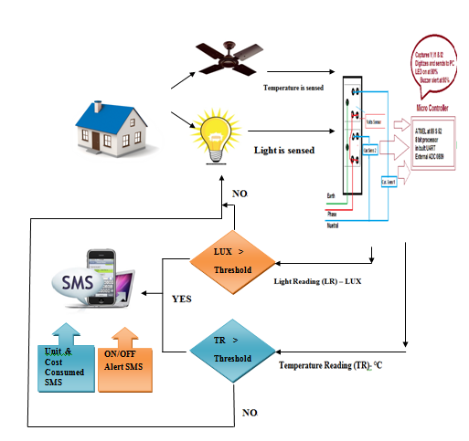
SYSTEM FLOW DIAGRAM
Smart Electricity Monitoring System (SEMS)
Department of Information Technology
Sri Sairam Engineering College

Slide 10
MODULES
MODULE 1: Parameters (Current, Voltage & Power) capturing & processing in MP Kit
MODULE 2: Temperature & Light sensing
MODULE 3: Energy computation using ASSEMBLY LANGUAGE code in MP Kit.
MODULE 4: Data sent to PC
MODULE 5: SMS alert is sent.
Smart Electricity Monitoring System (SEMS)
Department of Information Technology
Sri Sairam Engineering College

Slide 11
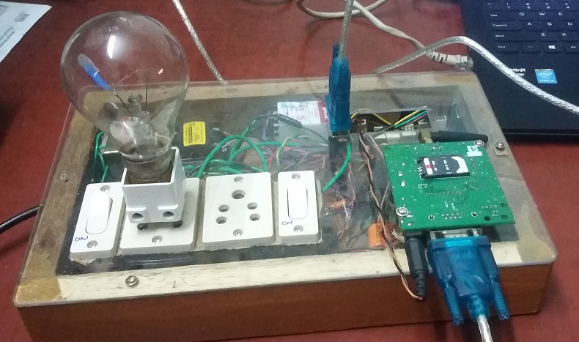
SCREENSHOT OF SMART ELECTRICITY MONITORING SYSTEM KIT
Smart Electricity Monitoring System (SEMS)
Department of Information Technology
Sri Sairam Engineering College

Slide 12
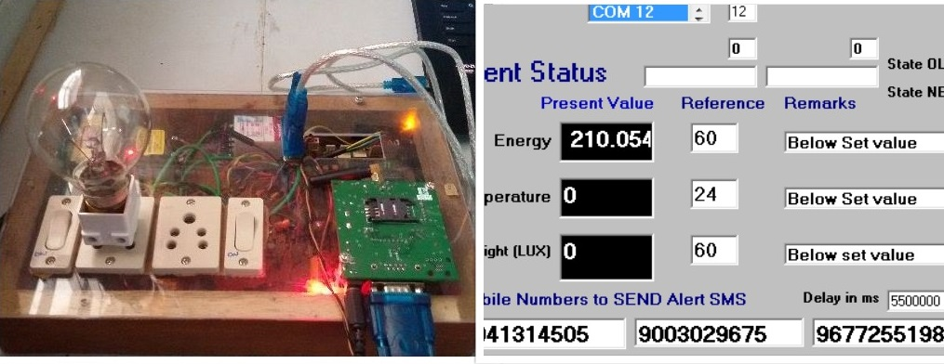
MODULE 1-PARAMETERS CAPTURING AND PROCESSING
Smart Electricity Monitoring System (SEMS)
Department of Information Technology
Sri Sairam Engineering College

Slide 13
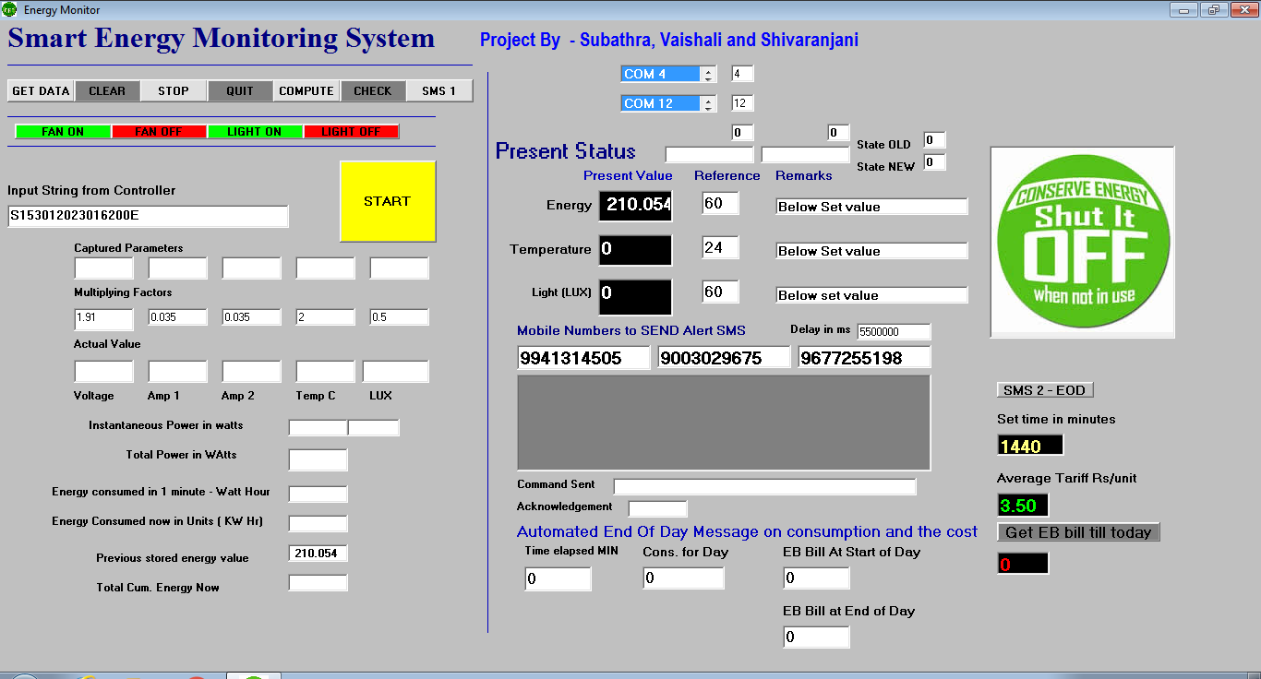
MODULE 1-PRE-DEFINING THRESHOLD
Smart Electricity Monitoring System (SEMS)
Department of Information Technology
Sri Sairam Engineering College

Slide 14
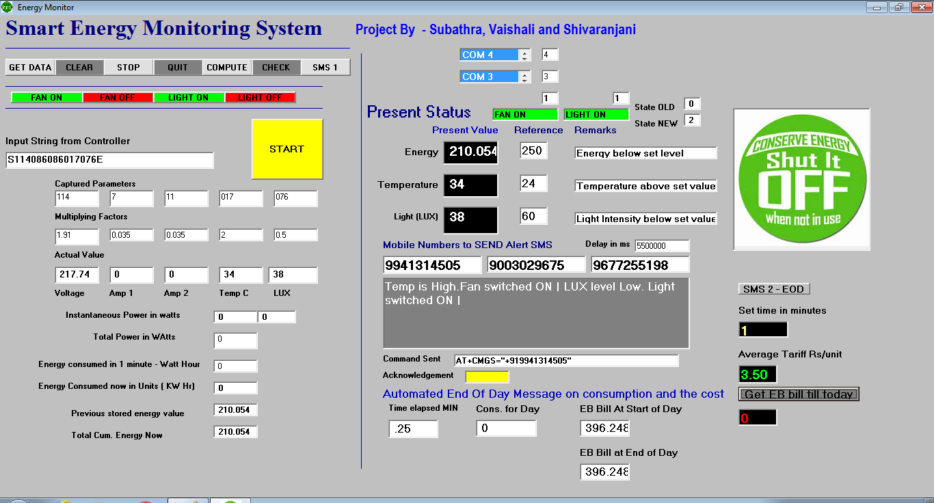
MODULE 2-COMPUTING ENERGY AND COST
Smart Electricity Monitoring System (SEMS)
Department of Information Technology
Sri Sairam Engineering College

Slide 15
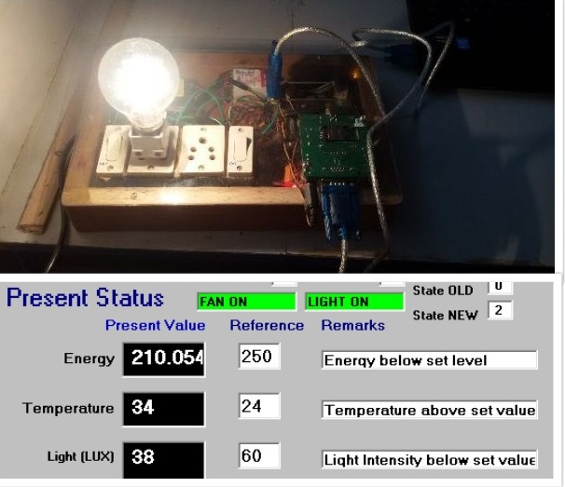
MODULE 3-COMPARING CONSUMED WITH THRESHOLD
Smart Electricity Monitoring System (SEMS)
Department of Information Technology
Sri Sairam Engineering College

Slide 16
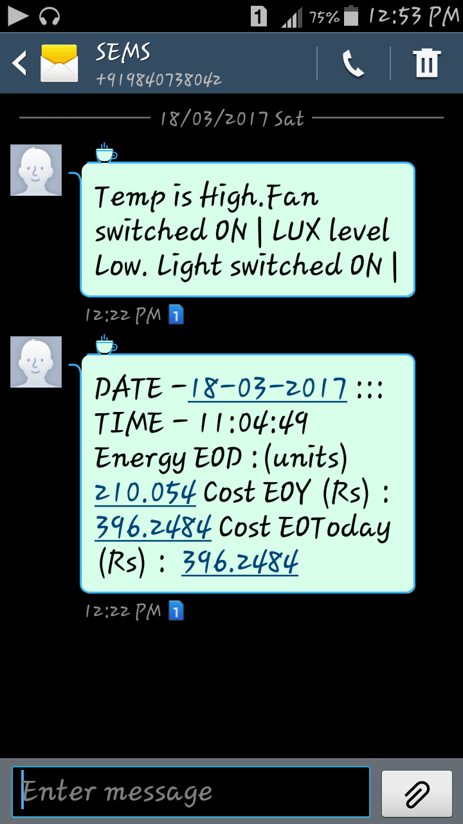
MODULE 4- SMS ALERT SENT
Smart Electricity Monitoring System (SEMS)
Department of Information Technology
Sri Sairam Engineering College

Slide 17
SAMPLE CODE
AT1:
Text41.Text = "AT" + Chr(13)
Text40.Text = ""
MSComm1.Output = Text41.Text
Text40.BackColor = vbBlue
MSComm1.InputLen = 0
Do
DoEvents
Loop Until MSComm1.InBufferCount >= 1
inval = MSComm1.Input
Text40.Text = inval
For i = 1 To del
DoEvents
Next i
If Text40.Text = "" Then
GoTo AT1
End If
Smart Electricity Monitoring System (SEMS)
Department of Information Technology
Sri Sairam Engineering College

Slide 18
SAMPLE CODE (Contd…)
ATCMGF1:
Text40.Text = ""
Text41.Text = "AT+CMGF=1" + Chr(13)
MSComm1.Output = Text41.Text
Text40.BackColor = vbGreen
MSComm1.InputLen = 0
Do
DoEvents
Loop Until MSComm1.InBufferCount >= 1
inval = MSComm1.Input
Text40.Text = inval
For i = 1 To del
DoEvents
Next i
If Text40.Text = "" Then
GoTo ATCMGF1
End If
Smart Electricity Monitoring System (SEMS)
Department of Information Technology
Sri Sairam Engineering College

Slide 19
SAMPLE CODE (Contd…)
ATCMGS1:
Text41.Text = Trim("AT+CMGS=" + """" + "+91" + Text33.Text + """")
Text40.Text = ""
MSComm1.Output = Text41.Text + Chr(13)
Text40.BackColor = vbYellow
For i = 1 To (del * 5)
DoEvents
Next i
Smart Electricity Monitoring System (SEMS)
Department of Information Technology
Sri Sairam Engineering College

Slide 20
SAMPLE CODE (Contd…)
SENDMES1:
MSComm1.Output = Text36.Text + Chr(13)
Text40.Text = ""
MSComm1.Output = Chr(26)
MSComm1.InputLen = 0
Do
DoEvents
Loop Until MSComm1.InBufferCount >= 1
inval = MSComm1.Input
Text40.Text = inval
If Text40.Text <> "" Then
Text41.Text = "The Message has been Sent"
End If
For i = 1 To del
DoEvents
Next i
Text40.Text = ""
Text40.BackColor = vbWhite
If MSComm1.PortOpen = True Then
MSComm1.PortOpen = False
End If
Smart Electricity Monitoring System (SEMS)
Department of Information Technology
Sri Sairam Engineering College

Slide 21
SAMPLE CODE (Contd…)
For computation of consumption and cost per day.
------------------------------------------------
Dim consday, consadd As Double
consday = Val(Trim(Text50.Text)) - the last stored for the day
consadd = consday + Val(Trim(Text30.Text)) - energy in last 15 seconds
Text50.Text = Str(consadd) - final energy now
Dim tcnt, tnow As Double
tcnt = Val(Trim(Text49.Text)) - last recorded time
tnow = tcnt + 0.25 - added 0.25minutes - 15 seconds
Text49.Text = Str(tnow) - time so far
Dim tarif, daycost As Double
tarif = Val(Trim(Text54.Text)) - assumed tariff for consumption upto 200 units
daycost = Round((tarif * consadd), 2)
Text51.Text = Str(daycost)
End If
Smart Electricity Monitoring System (SEMS)
Department of Information Technology
Sri Sairam Engineering College

Slide 22
SAMPLE CODE (Contd…)
sending SMS on consumption and energy
-------------------------------------
Dim tset, tnow As Double
tset = Val(Trim(Text52.Text))
tnow = Val(Trim(Text49.Text))
If tnow >= tset Then
Text36.Text = "DATE -" & Date & " ::: TIME - " & Time() & " Energy Today :(units) " & Text50.Text & " Cost Today (Rs) : " & Text51.Text
MsgBox " Send SMS"
Call Command11_Click
Text48.Text = "0"
Text49.Text = "0"
Text50.Text = "0"
Text51.Text = "0"
End If
Smart Electricity Monitoring System (SEMS)
Department of Information Technology
Sri Sairam Engineering College

Slide 23
REFERENCES
[1] Households electricity consumption analysis with data mining techniques
Usman Ali Concettina BuccellaA Carlo Cecati
IECON 2016 - 42nd Annual Conference of the IEEE Industrial Electronics Society year: 2016
[2] Electricity consumption analysis and power quality monitoring in commercial buildings
Imre Drovar; Jaan Niitsoo; Argo Rosin; Jako Kilter; Ivo Palu
2012 Electric Power Qualiy and Supply Reliability year: 2016
[3] Electricity-Metering in a Connected World: Virtual Sensors for Estimating the Electricity Consumption of IoT Appliances
Frank Englert; Patrick Lieser; Alaa Alhamoud; Doreen Boehnstedt;Ralf Steinmetz
2015 3rd International Conference on Future Internet of Things and Cloud year: 2015
[4] Analysis of the residential, commercial and industrial electricityconsumption
John D. Hobby; Gabriel H. Tucci
2011 IEEE PES Innovative Smart Grid Technologies year: 2015
[5]An Intelligent Energy Management Scheme with Monitoring and SchedulingApproach for IoT Applications in Smart Home
Tui-Yi Yang Chu-Sing Yang Tien-Wen Sung
2015 Third International Conference on Robot, Vision and Signal Processing (RVSP) year: 2015
Smart Electricity Monitoring System (SEMS)
Department of Information Technology
Sri Sairam Engineering College

Slide 24

Smart Electricity Monitoring System (SEMS)
Department of Information Technology
Sri Sairam Engineering College

